Slide 1
SPI
Getting Started
HCM - 18/09/2020

Slide 2
SPI introduction and overview
Physical interface
Daisy chain configuration
Data transmission
Clock polarity and phase
Applications

Slide 3
SPI - Features
Shorted for Serial Communication Protocol
Synchronous serial communication
Used for short distance normally in a PCB board
Full-duplex communication
A master-slave architecture with a single master
Multiple slaves supported
Not limited for data size transferred
Not limited to any maximum clock speed

Slide 4
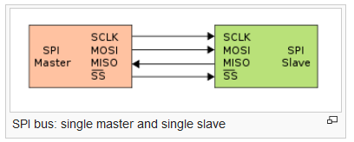
SPI – Physical interface
Physical Interface
  The SPI bus specifies four logic signals:
  SCLK : Serial Clock (output from master).
  MOSI : Master Output, Slave Input (output from master).
  MISO : Master Input, Slave Output (output from slave).
  SS : Slave Select (active low, output from master).

Slide 5
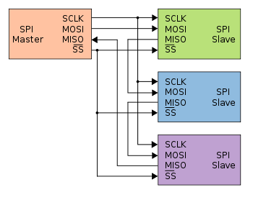
SPI- Daisy chain configuration
The first slave output being connected to the second slave input
The SPI port of each slave sends out during the second group of clock pulses an exact copy of the data it received during the first group of clock pulses.

Slide 6
SPI- Data transmission
The bus master configures the clock, then selects the slave device. The master must wait for a delay time before issuing clock cycles.
The master sends a bit on the MOSI line and the slave reads it, while the slave sends a bit on the MISO line and the master reads it
Transmission may continue for any number of clock cycles
When complete, the master stops toggling the clock signal, and typically deselects the slave.

Slide 7
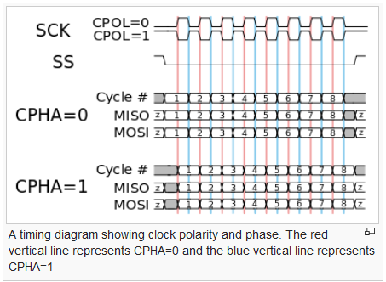
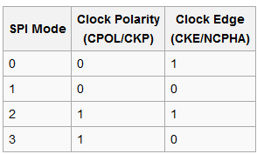
Clock polarity and phase
In setting the clock frequency, the master must configure the clock polarity and phase with respect to the data.
There are 4 modes for setting the clock frequency.

Slide 8
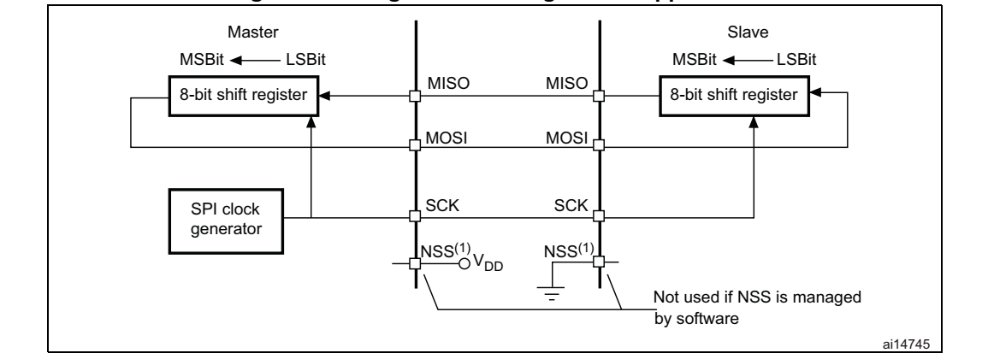
Single master/single slave
Single master/ single slave application

Slide 9
Applications
SPI is used to talk to a variety of peripherals, such as:
  Sensors: temperature, pressure, ADC/DAC, touchscreens, video game controllers
  Control devices: audio codecs, digital potentiometers, DAC
  Memory: flash and EEPROM
  Communications: Ethernet, USB, USART, CAN, IEEE 802.15.4, IEEE 802.11, hand-held video games
  Any MMC or SD card

Slide 10
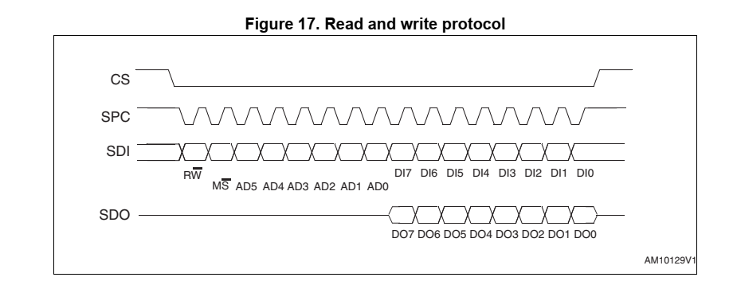
L3GD20H – SPI Timing

Slide 11
Q&A

